Slide 1


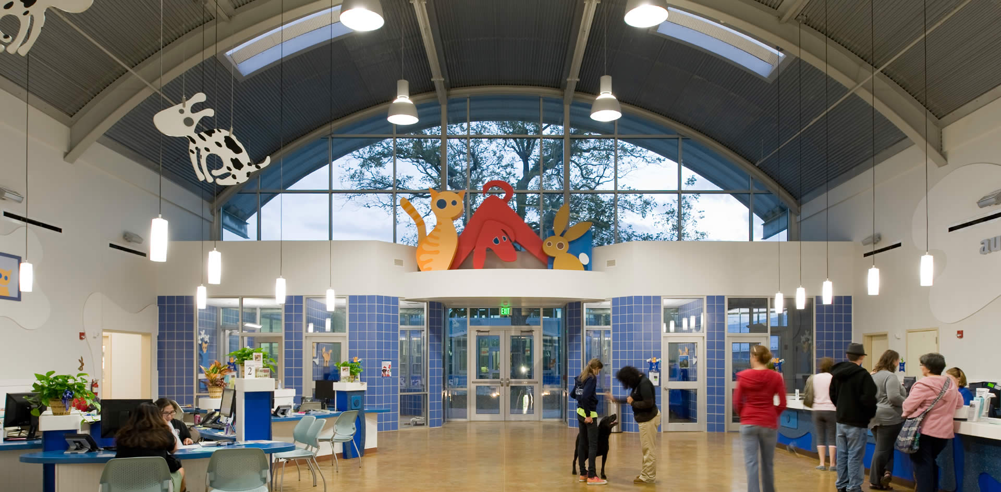




Austin Animal Shelter Analysis
Analysis of over 80,000 animal adoption intake and outcome data entries to predict the likelihood of adoption outcome
Prathima Bandi, Elijah Belizor, James Hook, Jack Kenning

Slide 2
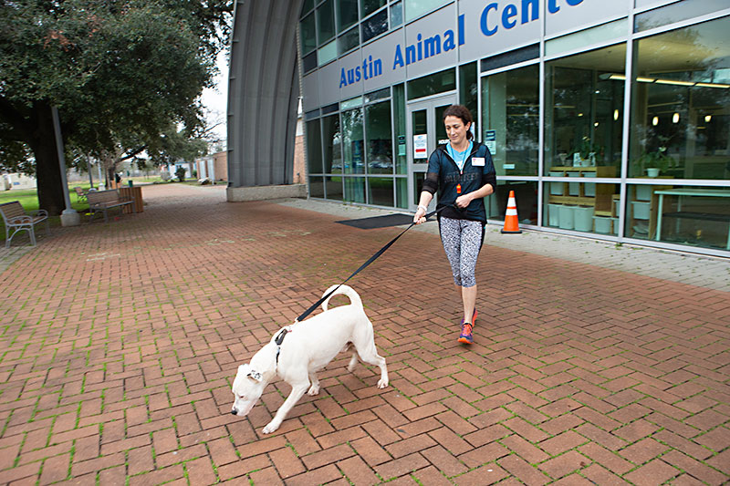
Study Overview and Questions to Answer
Austin Animal Center (AAC) is one of the largest no-kill animal shelters in the U.S, caring for over 18,000 animals per year
This study aims to explore factors influencing adoption outcomes and whether there is a predictable pattern
Through a supervised machine learning model, the goal is to attempt to predict adoption outcome for animals based on multiple criteria

Slide 3
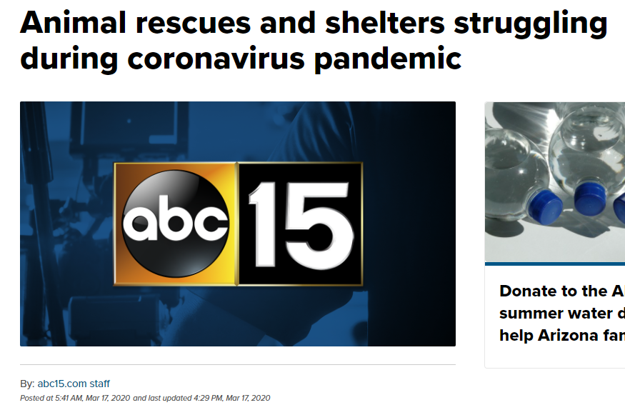
Why Analyze Animal Adoptions Data?
Potential to uncover useful insights to improve animal welfare in the area (and other regions)
Identify which types of animals may require additional support at shelters
Help prevent negative outcomes for identified high-risk animals
Assist with shelter resource, housing capacity, and budget planning
Shelters currently struggling to operate due to Covid-19 social distancing measures
Help inspire volunteer involvement in local animal welfare community

Slide 4
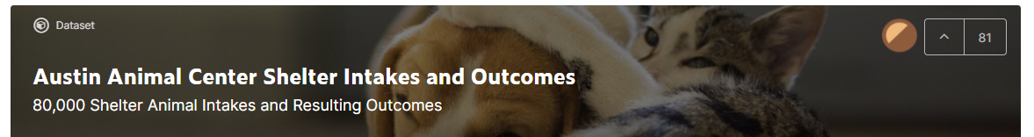

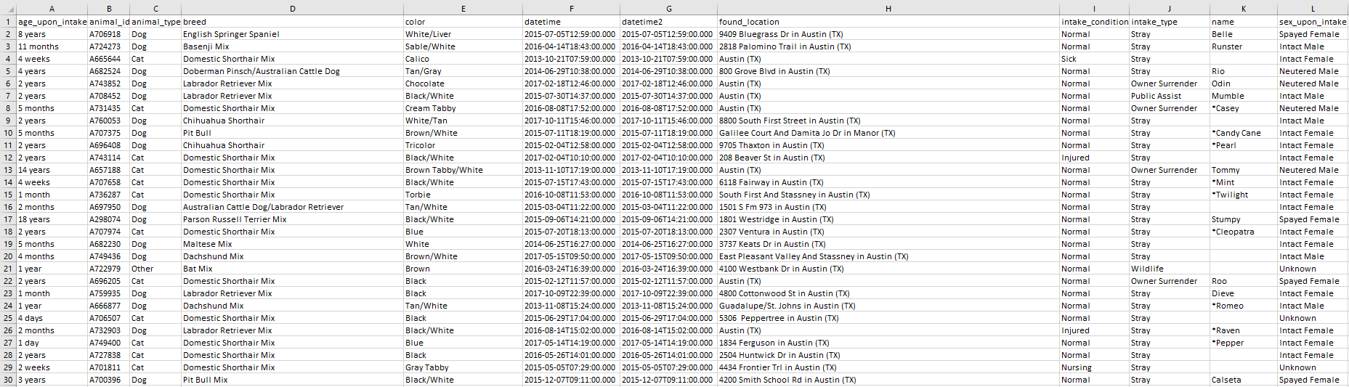
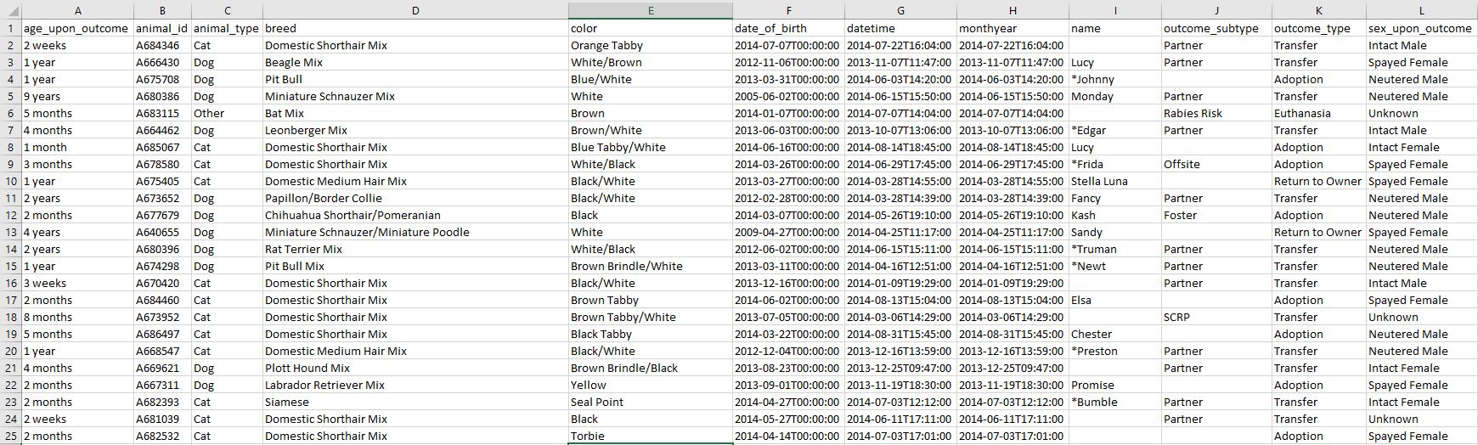
Where was the Dataset Sourced From?
Data sourced from a Kaggle dataset
Data publicly available as part of the City of Austin Open Data Initiative
Base dataset consists of separate tables for animal ‘intake’ and ‘outcome’ data, and a merged table (used by team)
Dataset info:
Ranges from October 2013-2018
>80,000 entries, 12 columns
Time/date data down to hourly frequency
Some animals enter/exit shelter multiple times
aac_intakes.csv
aac_outcomes.csv
Link to Kaggle Dataset: https://www.kaggle.com/aaronschlegel/austin-animal-center-shelter-intakes-and-outcomes

Slide 5












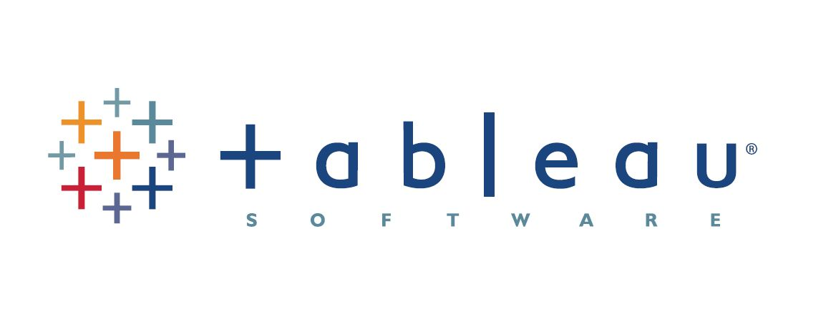
Resources Used By the Team
Software and Tools
Communication
Python - ETL, ML
Jupyter Notebook - IDE
Postgresql - database storage
Slack - primary method of communication for day-to-day project needs and logistics
Zoom - bi-weekly check-ins/code review and for peer-assists
Pandas - ETL
SciKitLearn - ML model
Matplotlib - exploratory visuals
Text message - alternate/backup communication
Phone call - emergencies
Tableau - interactive dashboard
Github - project storage
Google slides - this presentation!

Slide 6
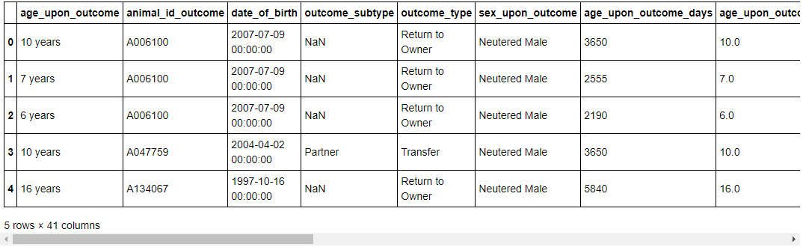
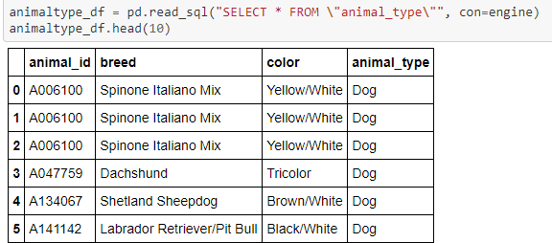
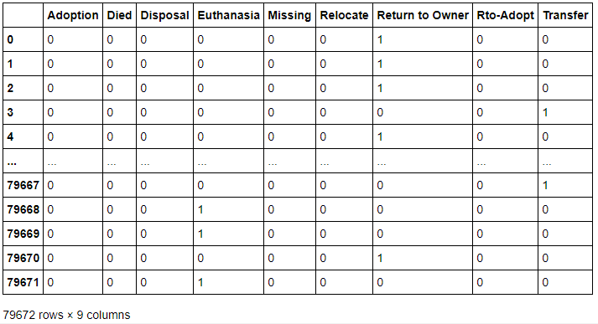
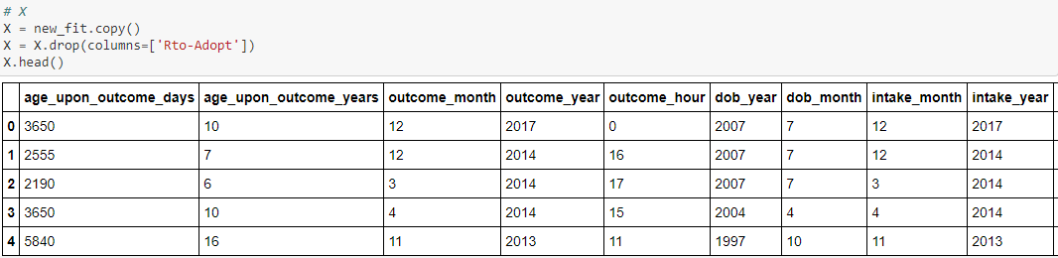
ETL Process Key Points Summary
1
2
Raw file that was brought into the database and renamed columns to match SQL format, made transformations
Animal lookup table created in SQL containing ‘static’ data types, animal_in_out table reduced to ‘changeable’ data (i.e. datetime differences for multiple intakes of same animal)
3
4
Final transformations made (e.g. drop target column, and additional categorical variables encoded) for final dataset then input to ml model
Both tables joined with a created id and dummies created for ml database target variable (outcome_type)

Slide 7
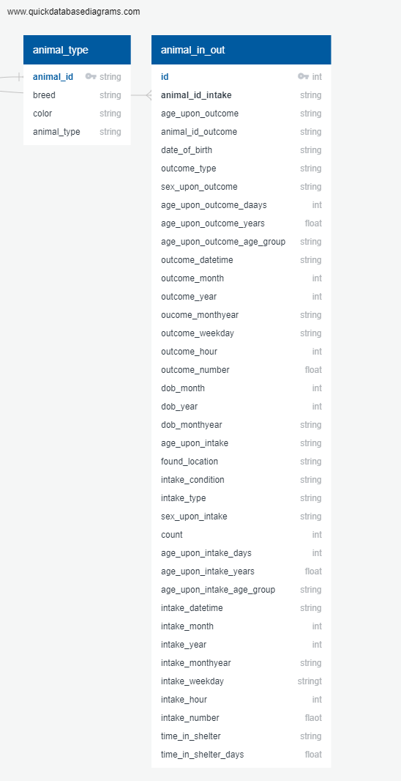
Data Exploration - SQL Database Creation Overview
‘Shelter_db’ created in PgAdmin
2) Database connection created with Pandas library to load in raw data
Postgres Database Schema - joined tables
‘animal_type’ table houses “static” data features
4) Copy created of raw data, transformations performed
3) SQL ‘Create’ script used to make master ‘animal_type’ table
‘animal_in_out’ table houses temporal data features that can change if an animal enters/exits shelter multiple times
5) Created ‘animal_in_out’ table as dataset for analysis

Slide 8
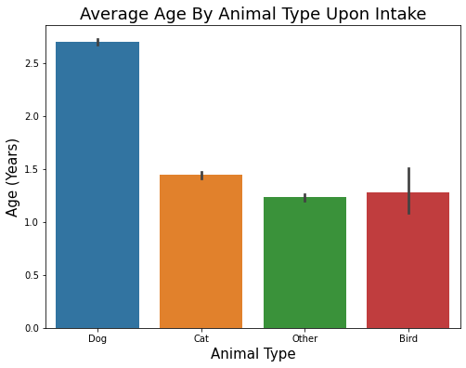
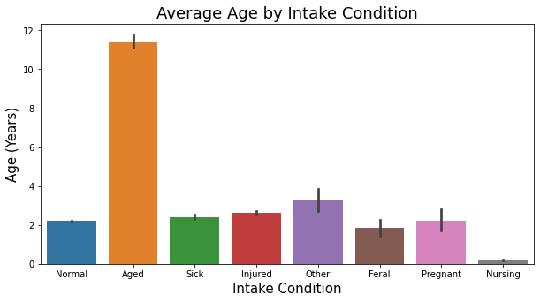
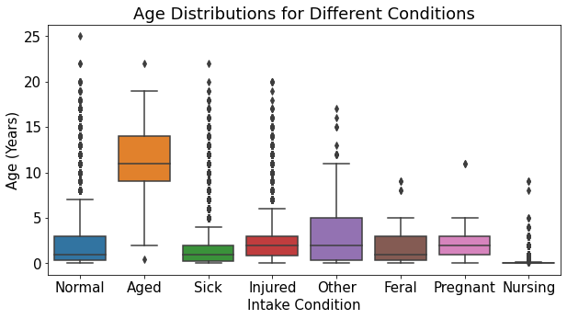
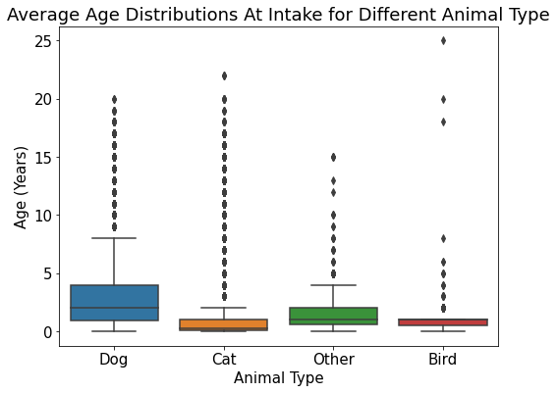
Exploratory Analysis - Animal Age Trends
On average dogs are older than other animals upon intake probably due to their longer lifespan
Unsurprisingly the the average age on intake condition is highest for animals classified as ‘aged’, other conditions are more or less even by comparison

Slide 9
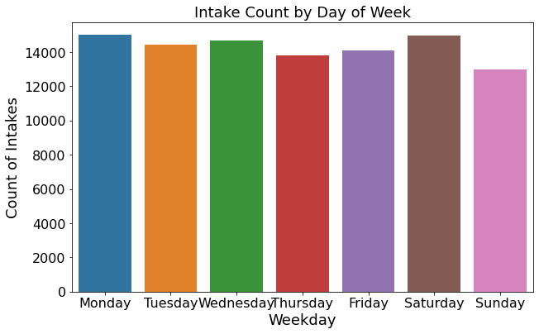
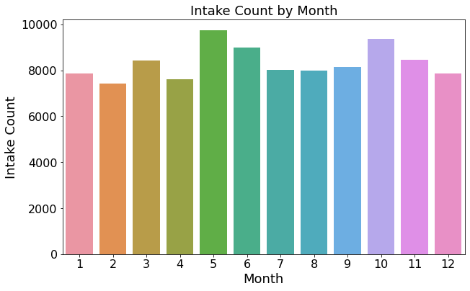
Exploratory Analysis - Intake Date/time Trends
Sunday is the least likely day that an animal will enter the shelter, followed by thursday and friday. Intakes are high at the start of the week from mondays, and also highest on saturdays
Early summer months in may and june see increased intakes counts for animals as well as approaching winter in october
*Consider transforming and adding time of day

Slide 10
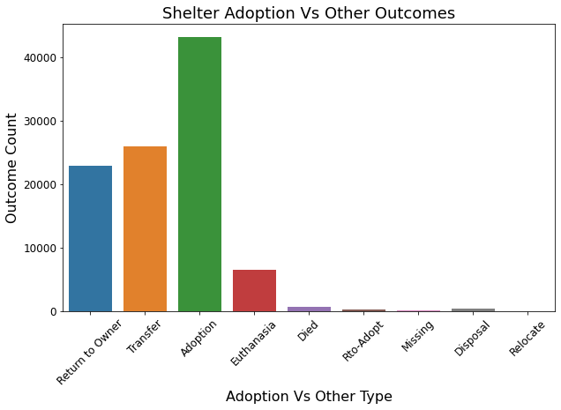
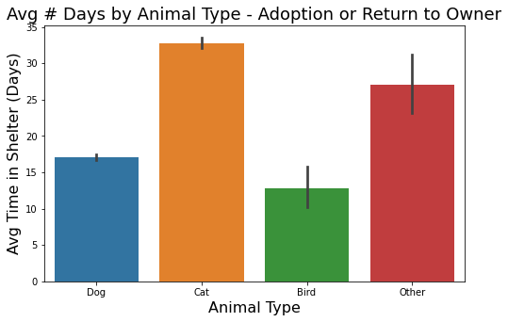
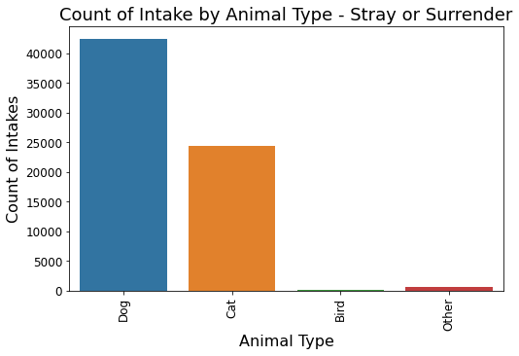
Exploratory Analysis - General Insights
Adoption is the most likely outcome for an animal overall by almost a factor of 2-1. However significant numbers are returned to owner or transferred. Other factors make up comparatively smaller proportion of outcomes - may decide to try to group when iterating ml model ?
Cats and miscellaneous other animals will generally spend the most time in the shelter compared to dogs and birds
Dogs are the most likely animal to be taken in as a stray or surrendered, followed by cats

Slide 11
Machine Learning Model Creation Overview
Connect model to database
2) Preprocess data (encode categorical variables)
3) Define target variable
5) Scale the data
4) Split data in Train and Test datasets
6) Plot the tree model
7) Plot the tree model
10) Iterate if necessary
9) Review confusion matrix, accuracy, classification report results
8) Make predictions from test data

Slide 12
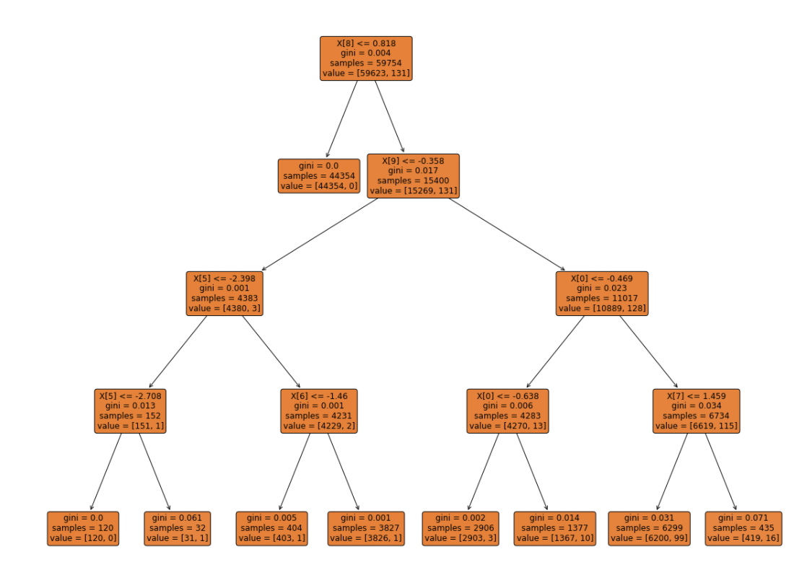
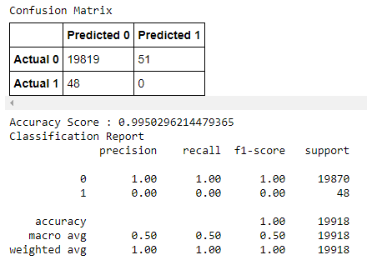
Machine Learning Model Analysis Results (So Far)
Decision Tree Model
Confusion Matrix and Classification Report
Adopted = 1
Not Adopted = 0
Plot of the current iteration of the decision tree model. The goal is to progressively split and separate samples with a more similar structure that will result in more pure subsets of data. The tree ends up with a series of branches (i.e. questions and answers) that eventually lead to a classification prediction representing a probability of a particular outcome.
Confusion matrix and classification report. The model is currently very accurate and managed to predict 48 out of 51 animals adopted and all animals not adopted correctly

Slide 13
Storyboard for Tableau Dashboard Outline
Data count and selection tool makes sense to start
3
Temporal impacts on intake and outcome
4
Age specific controls on intake and outcome
1
2
High level overview charts of data
Total animal count
Selection menu (dropdown or checkbox combo filters for each variable in dataset - controls all relevant chart displays)
Pie chart showing counts by outcome type
Heat map of outcome type count vs days of the week
Age upon intake vs. count per outcome type (multi-line graph)
Age upon outcome vs. count per outcome type (multi-line graph)
Total currently selected animal count
Animal type vs. intake count bar chart
Heat map of outcome type count vs months of the year
Adoption outcome is target variable and most important to see relationships with all other variables, multiple smaller charts here need to be heat maps as vs. categorical variables remaining
5
Multiple correlation matrixes/heat maps for adoption outcome type count vs each variable (animal type, breed, color, age on intake, age on outcome, sex on intake, sex on outcome)
Data table mini-inset (results filter based on selection menu above, searchable/scrollable)
Animal type vs. time in shelter bar chart
Time in shelter vs. count per outcome type (multi-line graph)
Data table
Selectable Tabs in Tableau to further explore
Tabs for each individual chart
6
Dashboard
Story

